Slide 1
Chapter 8: Main Memory
Modified by Maria

Slide 2
Chapter 8: Memory Management
Background
Swapping
Contiguous Memory Allocation
Segmentation
Paging
Structure of the Page Table
Example: The Intel 32 and 64-bit Architectures
Example: ARM Architecture

Slide 3
Objectives
To provide a detailed description of various ways of organizing memory hardware
To discuss various memory-management techniques, including paging and segmentation
To provide a detailed description of the Intel Pentium, which supports both pure segmentation and segmentation with paging

Slide 4
Background
Program must be brought (from disk) into memory and placed within a process for it to be run
Main memory and registers are only storage CPU can access directly
Memory unit only sees a stream of addresses + read requests, or address + data and write requests
Register access in one CPU clock (or less)
Main memory can take many cycles, causing a stall
Cache sits between main memory and CPU registers
Protection of memory required to ensure correct operation
Notes:
-Multiple processes in memory simultaneously – have to be managed.
-Machine instructions only refer to memory addresses, not disk addresses. So instructions and data have to be moved into memory first (or registers).
-Memory management algorithms depend heavily on the hardware design of the system.
-To reduce time to access memory (as memory access is a frequent event), cache is added.
-Processes in memory need to be protected from each other, and also OS needs to be protected from users.
-This protection provided by hardware.

Slide 5
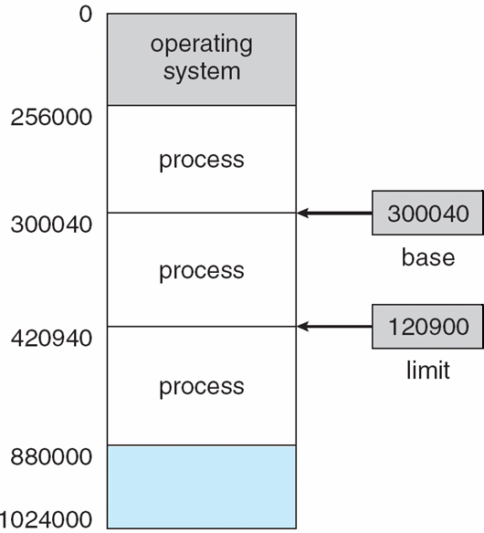
Base and Limit Registers
A pair of base and limit registers define the addresses
CPU must check every memory access generated in user mode to be sure it is between base and limit for that user
Notes:
-A scheme to protect memory space i.e. allow only legal memory space accesses.
-Concept of address space analogous to the concept of telephone number space (8 digits in Lahore).
-Base register has the smallest possible legal physical address and limit register has the length of the process.
-The OS checks (in kernel mode of course) that each user process only issues legal addresses i.e. within its logical address space, by comparing each address with those in base and limit registers.
-If not, then there is a trap and error.
-Only the kernel can access/load these registers through privileged instructions.
-Some processors (e.g. Intel 8088) didn’t have limit register but only base register. This means no checking performed for out-of-range addresses issued by programs. Some have multiple registers for program text and data separate relocation.
-Disadvantages of this scheme? Doesn’t support well data structures like stacks and queues, or multiprogramming. Also, performing comparisons is quick but additions are slower (comparison and addition have to be performed per memory reference).

Slide 6
Hardware Address Protection

Slide 7
Address Binding
Programs on disk, ready to be brought into memory to execute form an input queue
Without support, must be loaded into address 0000
Inconvenient to have first user process physical address always at 0000
How can it not be?
Further, addresses represented in different ways at different stages of a program’s life
Source code addresses usually symbolic
Compiled code addresses bind to relocatable addresses
i.e. “14 bytes from beginning of this module”
Linker or loader will bind relocatable addresses to absolute addresses
i.e. 74014
Each binding maps one address space to another
Notes:
-Symbolic address is the name given to a variable (memory location) in source code.

Slide 8
Binding of Instructions and Data to Memory
Address binding of instructions and data to memory addresses can happen at three different stages
Compile time: If memory location known a priori, absolute code can be generated; must recompile code if starting location changes
Load time: Must generate relocatable code if memory location is not known at compile time where the process will reside then final binding is delayed till load time
Execution time: Binding delayed until run time if the process can be moved during its execution from one memory segment to another
Need hardware support for address maps (e.g., base and limit registers)
Notes:
-Relocatable code needed for load time binding because if loading starting address changes, have to reload code. Once loaded, it becomes fixed.
Compiler will bind symbolic addresses to relocatable addresses (such as “14 bytes from the beginning of this module”). A table of such relocatable memory references is produced by the compiler/assember.
The linkage editor or loader will bind these relocatable addresses to absolute addresses (such as 12230).
If starting address changes, no recompilation needed; only the loader has to translate the table of relocatable references to the new addresses.
http://www.encyclopedia.com/doc/1O11-relocatablecode.html
-Most OSes do execution time binding. Special hardware needed for this, as
discussed in the next section.
http://www.encyclopedia.com/doc/1O11-positionindependentcode.html
For an intro to linking:
http://en.wikipedia.org/wiki/Linker_(computing)
A good book to know all about linking and loading, if you are interested:
http://www.iecc.com/linker/

Slide 9
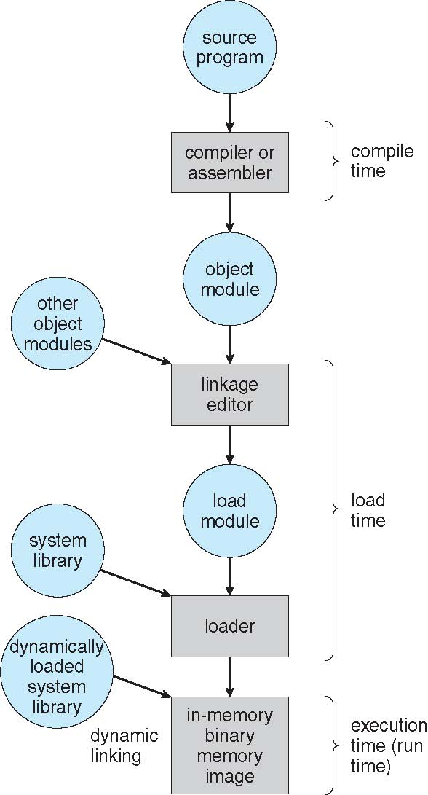
Multistep Processing of a User Program
Notes:
-Loader is part of OS.

Slide 10
Logical vs. Physical Address Space
The concept of a logical address space that is bound to a separate physical address space is central to proper memory management
Logical address – generated by the CPU; also referred to as virtual address
Physical address – address seen by the memory unit
Logical and physical addresses are the same in compile-time and load-time address-binding schemes; logical (virtual) and physical addresses differ in execution-time address-binding scheme
Logical address space is the set of all logical addresses generated by a program
Physical address space is the set of all physical addresses generated by a program
Notes:
-A logical address is the address at which an item (memory cell, storage element, network host) appears to reside from the perspective of an executing application program. A logical address may be different from the physical address due to the operation of an address translator or mapping function. Such mapping functions may be, in the case of a computer memory architecture, a memory management unit (MMU) between
the CPU and the memory bus, or an address translation layer, e.g., the Data Link Layer, between the hardware and the internetworking protocols (Internet Protocol) in a computer networking system.
-Virtual Address Space: http://en.wikipedia.org/wiki/Virtual_address_space

Slide 11
Memory-Management Unit (MMU)
Hardware device that at run time maps virtual to physical address
Many methods possible, covered in the rest of this chapter
To start, consider simple scheme where the value in the relocation register is added to every address generated by a user process at the time it is sent to memory
Base register now called relocation register
The user program deals with logical addresses; it never sees the real physical addresses
Logical address bound to physical addresses

Slide 12
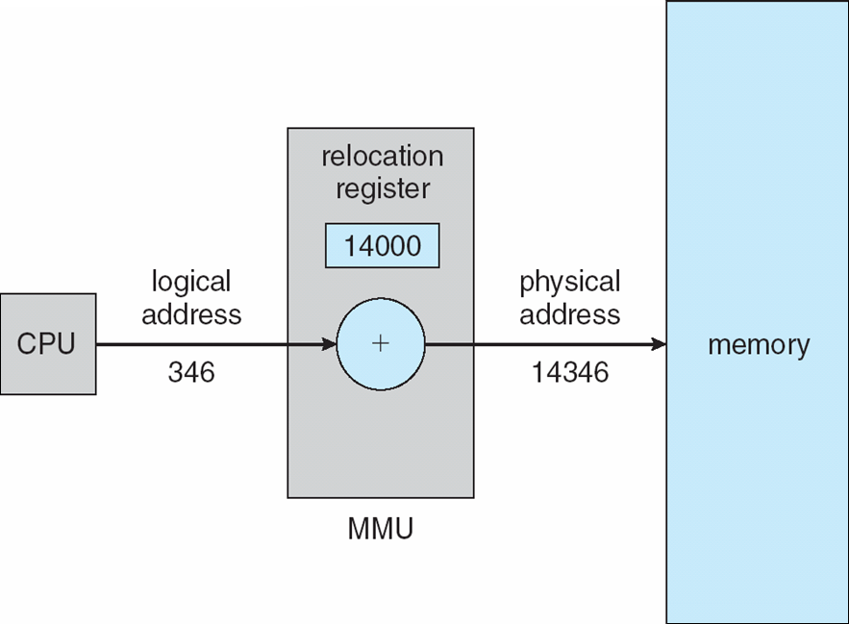
Dynamic relocation using a relocation register
Routine is not loaded until it is called
Better memory-space utilization; unused routine is never loaded
All routines kept on disk in relocatable load format
Useful when large amounts of code are needed to handle infrequently occurring cases
OS can help by providing libraries to implement dynamic loading
Notes:
-Example can be infrequently used error-handling routines.

Slide 13
Dynamic Linking
Static linking – system libraries and program code combined by the loader into the binary program image
linker copying all library routines used in the program into the executable image
Dynamic linking – linking postponed until execution time
Small piece of code, stub, used to locate the appropriate memory-resident library routine
Stub replaces itself with the address of the routine, and executes the routine
Operating system checks if routine is in processes’ memory address
If not in address space, add to address space
Dynamic linking is particularly useful for libraries
multiple programs can share a single copy of the library (shared libraries)
Notes:
-Can be used for system libraries such as language subroutine libraries.
-One of the biggest disadvantages of dynamic linking involves the executables depending on the separately stored libraries in order to function properly. If the library is deleted, moved, or renamed, or if an incompatible version of the DLL (dynamically linked library) is copied to a place that is earlier in the search, the executable would fail to load.
On Windows this is commonly known as DLL hell. Otherwise as Dependency hell.
http://en.wikipedia.org/wiki/Shared_library#Locating_libraries_at_run_time
-The runtime performance costs of dynamic linking are substantial compared to those of static linking, since a large part of the linking process has to be redone every time a program runs. Every dynamically linked symbol used in a program has to be looked up in a symbol table and resolved.
-Called DLL’s in Windows terminology and shared objects in POSIX terms (files have .so extension).

Slide 14
Swapping
A process can be swapped temporarily out of memory to a backing store, and then brought back into memory for continued execution
Total physical memory space of processes can exceed physical memory
Backing store – fast disk large enough to accommodate copies of all memory images for all users; must provide direct access to these memory images
Roll out, roll in – swapping variant used for priority-based scheduling algorithms; lower-priority process is swapped out so higher-priority process can be loaded and executed
Major part of swap time is transfer time; total transfer time is directly proportional to the amount of memory swapped
System maintains a ready queue of ready-to-run processes which have memory images on disk
Context-switch time is high for this swap-out, swap-in technique.
Notes:
-E.g. during RR scheduling, an expired quantum process swapped out and the next one brought in.
-Can also swap out a process that is not requiring service at a high rate, e.g. a sleepy user using an interactive program. So process still running but swapped out. Can also swap out if blocked for I/O.
-Restarted process can start in a different memory space if execution-time binding.
-Context-switch time is high for this swap-out, swap-in technique.

Slide 15
Swapping (Cont.)
Does the swapped out process need to swap back in to same physical addresses?
Depends on address binding method
Plus consider pending I/O to/from process memory space
Modified versions of swapping are found on many systems (i.e., UNIX, Linux, and Windows)
Swapping normally disabled
Started if more than threshold amount of memory allocated
Disabled again once memory demand reduced below threshold
Notes:
-Can only swap out a completely idle process. If process is waiting for I/O operation, have to make sure that I/O not done in the memory space of new swapped-in process. Either wait till I/O completes, or do I/O only with OS buffers so that the swapped out process can get the I/O from the OS buffers when it is swapped back in.
-Not much used technique in modern OSes.

Slide 16
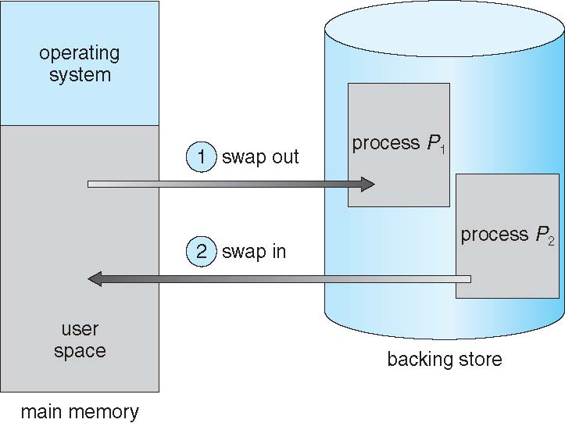
Schematic View of Swapping

Slide 17
Context Switch Time including Swapping
If next processes to be put on CPU is not in memory, need to swap out a process and swap in target process
Context switch time can then be very high
100MB process swapping to hard disk with transfer rate of 50MB/sec
Swap out time of 2000 ms
Plus swap in of same sized process
Total context switch swapping component time of 4000ms (4 seconds)
Notes:
-A process with dynamic memory requirements will need to issue system calls (request memory() and release memory()) to inform the operating system of its changing memory needs.

Slide 18
Context Switch Time and Swapping (Cont.)
Other constraints as well on swapping
Pending I/O – can’t swap out as I/O would occur to wrong process
Or always transfer I/O to kernel space, then to I/O device
adds overhead
Standard swapping not used in modern operating systems
But modified version common
Swap only when free memory extremely low

Slide 19
Swapping on Mobile Systems
Not typically supported
Flash memory based
Small amount of space
Limited number of write cycles
Instead use other methods to free memory if low
iOS asks apps to voluntarily relinquish allocated memory
Read-only data thrown out and reloaded from flash if needed
Failure to free can result in termination
Android terminates apps if low free memory, but first writes application state to flash for fast restart
Both OSes support paging as discussed below
Notes:
-Because of these restrictions, developers for mobile systems must carefully allocate and release memory to ensure that their applications do not use too much memory or suffer from memory leaks.

Slide 20
Contiguous Allocation
Main memory must support both OS and user processes
Limited resource, must allocate efficiently
Contiguous allocation is one early method
Main memory usually into two partitions:
Resident operating system, usually held in low memory
User processes then held in high memory
Each process contained in single contiguous section of memory

Slide 21
Contiguous Allocation (Cont.)
Relocation registers used to protect user processes from each other, and from changing operating-system code and data
Base register contains value of smallest physical address
Limit register contains range of logical addresses – each logical address must be less than the limit register
MMU maps logical address dynamically
Notes:
-Address relocation is also called address translation.
-Relocation register acts as the base register.
-These registers loaded by the dispatcher as part of the context switch.
-Size of OS can change as some device drivers or some other code not needed sometimes. This allocation scheme can cater for changing size of
the OS code during program execution. New processes relocated to an earlier or later address depending on OS size.

Slide 22
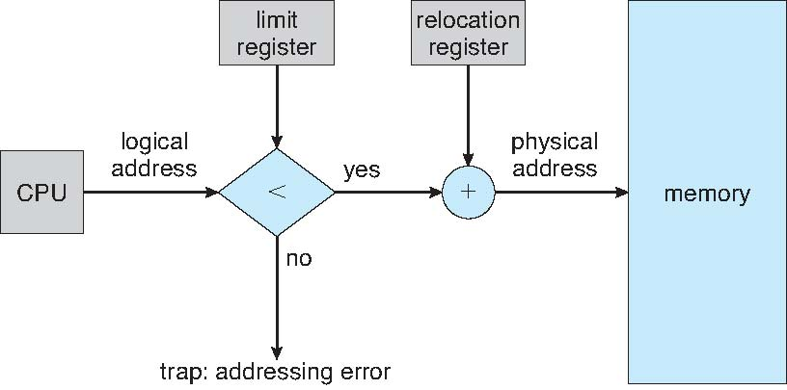
Hardware Support for Relocation and Limit Registers

Slide 23
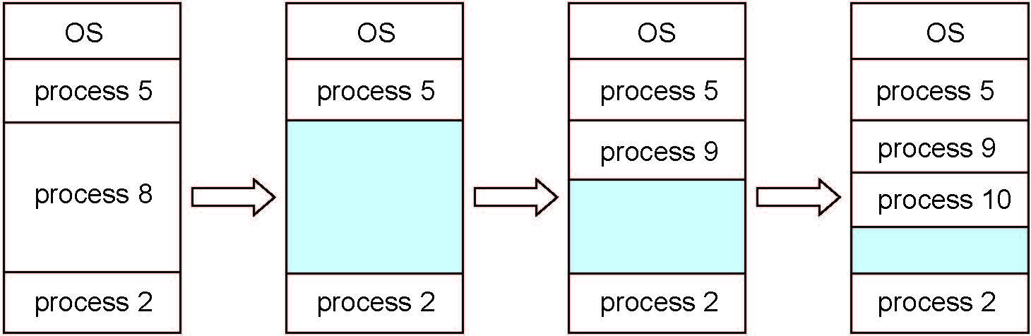
Multiple-partition allocation
Multiple-partition allocation
Degree of multiprogramming limited by number of partitions
Variable-partition sizes for efficiency (sized to a given process’ needs)
Hole – block of available memory; holes of various size are scattered throughout memory
When a process arrives, it is allocated memory from a hole large enough to accommodate it
Process exiting frees its partition, adjacent free partitions combined
Operating system maintains information about: a) allocated partitions b) free partitions (hole)

Slide 24
Dynamic Storage-Allocation Problem
How to satisfy a request of size n from a list of free holes?
First-fit: Allocate the first hole that is big enough
Best-fit: Allocate the smallest hole that is big enough; must search entire list, unless ordered by size
Produces the smallest leftover hole
Worst-fit: Allocate the largest hole; must also search entire list
Produces the largest leftover hole
First-fit and best-fit better than worst-fit in terms of speed and storage utilisation
Notes:
-First-fit faster than Best-fit.
-http://www1bpt.bridgeport.edu/sed/projects/cs503/Spring_2001/kode/os/memory.htm#algorithms

Slide 25
Fragmentation
External Fragmentation – total memory space exists to satisfy a request, but it is not contiguous
Internal Fragmentation – allocated memory may be slightly larger than requested memory; this size difference is memory internal to a partition, but not being used
First fit analysis reveals that given N blocks allocated, 0.5 N blocks lost to fragmentation
1/3 may be unusable -> 50-percent rule
Notes:
-Consider a process in memory. About 50% of the time there are allocations and the rest are deallocations. So each process has a hole above it 50% of the time. If there are n processes, then the expected number of holes is 0.5n. Of these 0.5n holes, 50% are unusable. I.e. 1/3rd unusable because N block are allocate and 0.5N of the remaining holes are usable. That is, 1.5N are usable and 0.5N are unusable due to fragmentation. Hence, 1/3rd are unusable (0.5N out of 1.5N).

Slide 26
External Fragmentation
External Fragmentation - total memory space exists to satisfy request but it is not contiguous
OS
50k
process 3
125k
Process 9
?
process 8
100k
process 2

Slide 27
Fragmentation (Cont.)
Reduce external fragmentation by compaction
Shuffle memory contents to place all free memory together in one large block
Compaction is possible only if relocation is dynamic, and is done at execution time

Slide 28
Segmentation
Memory-management scheme that supports user view of memory
A program is a collection of segments
A segment is a logical unit such as:
main program
procedure
function
method
object
local variables, global variables
common block
stack
symbol table
arrays
Notes:
-Each segment has a name and a length.
-The compiler automatically constructs segments reflecting the input program.
-Otherwise, the programmer has to be aware of the segments and code accordingly. This is an inconvenience.

Slide 29
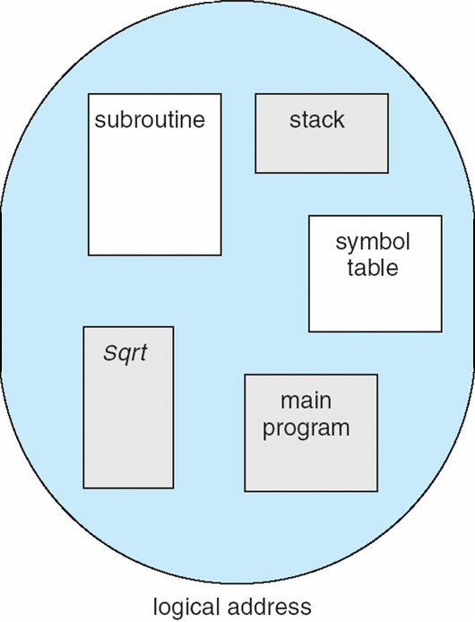
User’s View of a Program
Notes:
-A symbol table is a data structure used by a language translator such as a compiler or interpreter, where each identifier in a program's source code is associated with information relating to its declaration or appearance in the source, such as its type, scope level and sometimes its location.

Slide 30
Logical View of Segmentation
1
1
4
2
3
4
2
3
user space
physical memory space
Notes:
-Doesn’t have internal fragmentation problem.
-Has external fragmentation problem. But as process divided into several smaller pieces, it is less severe.

Slide 31
Segmentation Architecture
Logical address consists of a two tuple:
<segment-number, offset>,
Segment table – maps two-dimensional physical addresses; each table entry has:
base – contains the starting physical address where the segments reside in memory
limit – specifies the length of the segment
Segment-table base register (STBR) points to the segment table’s location in memory
Segment-table length register (STLR) indicates number of segments used by a program;
segment number s is legal if s < STLR
Notes:
-For simplicity, a segment number is used instead of segment name.
-STBR and STLR are CPU registers.
Pronunciation: http://www.howjsay.com/index.php?word=tuple&submit=Submit
(a good site to check pronunciation of words; gives both british and american variants; of course the former is better ☺)

Slide 32
Segmentation Architecture (Cont.)
Protection
With each entry in segment table associate:
validation bit = 0 ⇒ illegal segment
read/write/execute privileges
Protection bits associated with segments
Since segments vary in length, memory allocation is a dynamic storage-allocation problem
A segmentation example is shown in the following diagram
Notes:
-As each segment is a different beast, can provide specific protection. In paging, this is not so.

Slide 33
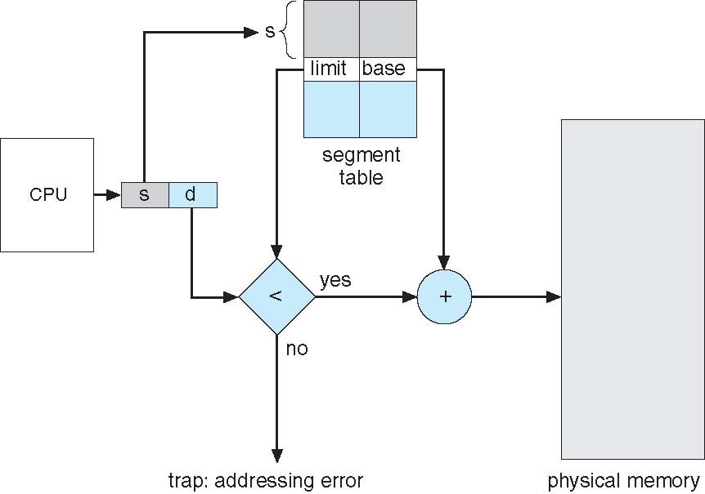
Segmentation Hardware
Notes:
-Virtual address consists of a segment number s and an offset d into that segment.
-Offset d should be less than the segment limit. If not, error.
-Segment table is basically an array of base-limit pairs.

Slide 34
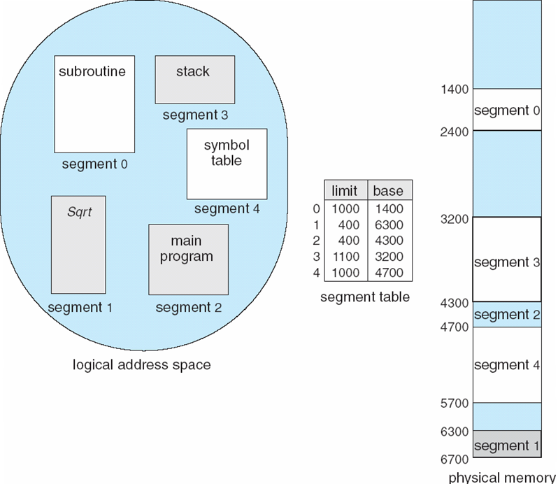
Example of Segmentation
Notes:
34
-A reference to byte 53 of segment 2 is mapped onto location 4300 + 53 = 4353.
-A reference to byte 1002 of segment 0 results in a trap to OS.

Slide 35
Paging
Paging is another memory-management scheme that offers memory to be noncontiguous;
Avoids external fragmentation
Avoids problem of varying sized memory chunks
Divide physical memory into fixed-sized blocks called frames
Size is power of 2, between 512 bytes and 16 Mbytes
Divide logical memory into blocks of same size called pages
Keep track of all free frames
To run a program of size N pages, need to find N free frames and load program
Set up a page table to translate logical to physical addresses
Backing store likewise split into pages
Still have Internal fragmentation
Notes:
-A memory management scheme to avoid the problem of fitting various sized chunks of memory onto the backing store during swapping out. Backing store suffers from same fragmentation problems as main memory and can’t have compaction as the disk is too slow to do that.
-Frame size depends on the computer’s architecture.
-Worst internal fragmentation per process: if process is n pages plus one byte. Then almost an entire frame wasted.
http://en.wikipedia.org/wiki/Virtual_memory

Slide 36
Address Translation Scheme
Address generated by CPU is divided into:
Page number (p) – used as an index into a page table which contains base address of each page in physical memory
Page offset (d) – combined with base address to define the physical memory address that is sent to the memory unit
For given logical address space 2^{m} and page size 2^{n}
Notes:
-Each process has its own page table.
-n bits required to represent page size of 2^{n}.
-Out of total m bits, the higher m-n bits are the page number, and lower n bits (d ) denote page offset.
-Different sizes for page can be chosen, changing n.
http://en.wikipedia.org/wiki/Virtual_address_space

Slide 37
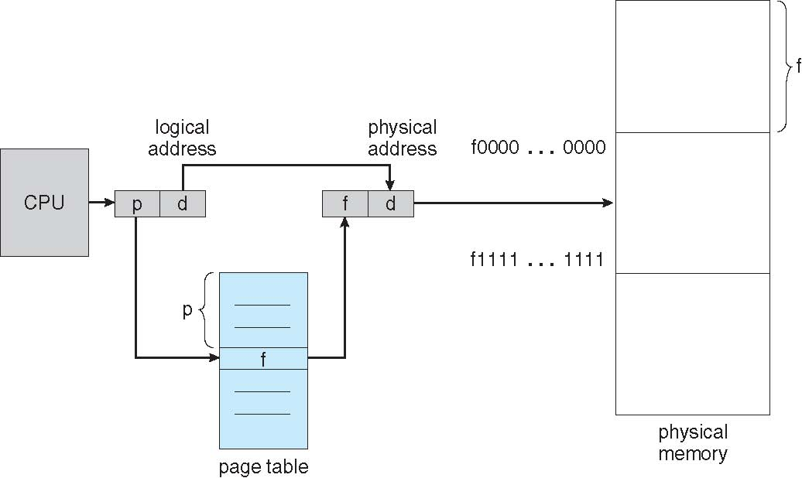
Paging Hardware

Slide 38
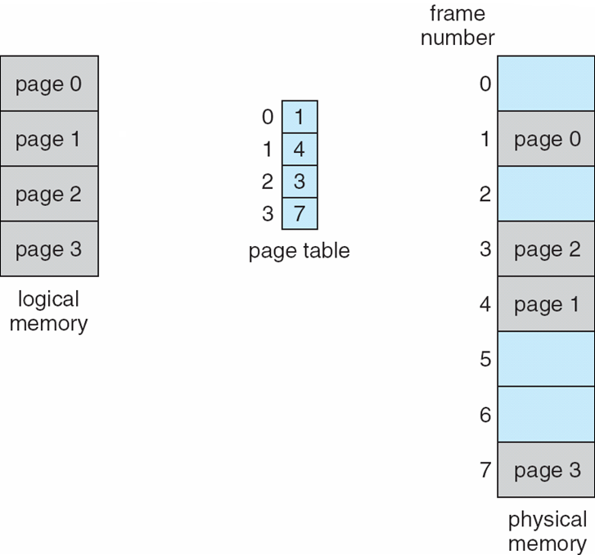
Paging Model of Logical and Physical Memory
Notes:
-Paging itself is a type of dynamic relocation. It dynamically relocates each page to a frame.
-A user process can only access memory accessible through its own page table; hence protection is achieved.
-User process has illusion of dealing with contiguous memory, while it is actually distributed across physical memory, and shares the physical memory with other process’s pages.
-Increases context-switch time as the page table also has to be loaded by OS.

Slide 39
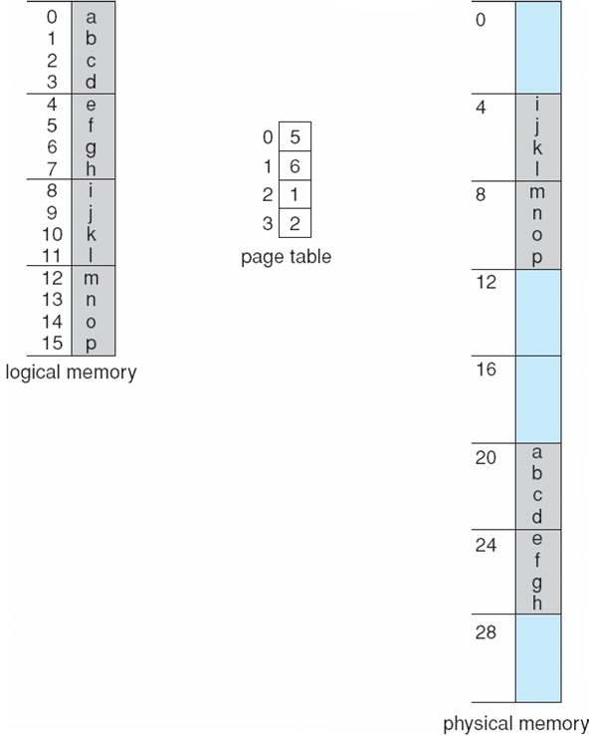
Paging Example
n=2 and m=4 32-byte memory and 4-byte pagesize
Notes:
-4 byte pages for both logical and physical memory.
-Total address space is 32 bytes (0 – 31), so 4-bit logical address generated.
-Page size is 4 bytes. Hence m is 4 and n is 2.
-We want to map a logical address byte to the physical address byte.
-Logical address 0 is page 0, offset 0. Indexing into page table, we find that page 0 is in frame 5.
Thus, logical address 0 maps to physical address [(5x4)+0] i.e. 20. So character a is stored at physical memory address 20.
Similarly logical address 9 (j) is page 2, offset 1. This translates to frame number 1 and physical memory address [(1x4)+1] i.e. 5.
-In terms of binary, logical address 0 would be 0000, and logical address 9 would be 1001, which correctly depict the page numbers and offsets with the upper m-n and lower n bits respectively.
Against 10 (binary) page, you get frame 01 (binary) from page table.
We can now replace the higher m-n bits (2 bits) that represented the page with the bits representing the frame. This means replacing the 2 higher order bits in 1001 with 01. This gives the memory address 0101 i.e. byte 5. This is the location of byte number decimal 9 (j) in physical memory. OR, use the last 2 bits 01 as offset into the frame to arrive at the same place as before.

Slide 40
Paging (Cont.)
Calculating internal fragmentation
Page size = 2,048 bytes
Process size = 72,766 bytes
35 pages + 1,086 bytes
Internal fragmentation of 2,048 - 1,086 = 962 bytes
Worst case fragmentation = 1 frame – 1 byte
On average fragmentation = 1 / 2 frame size
So small frame sizes desirable?
But each page table entry takes memory to track
Page sizes growing over time
Solaris supports two page sizes – 8 KB and 4 MB
Process view and physical memory now very different
By implementation process can only access its own memory
Notes:
-Also, more efficient to transfer larger amounts of data together in one go, favouring large page size.

Slide 41
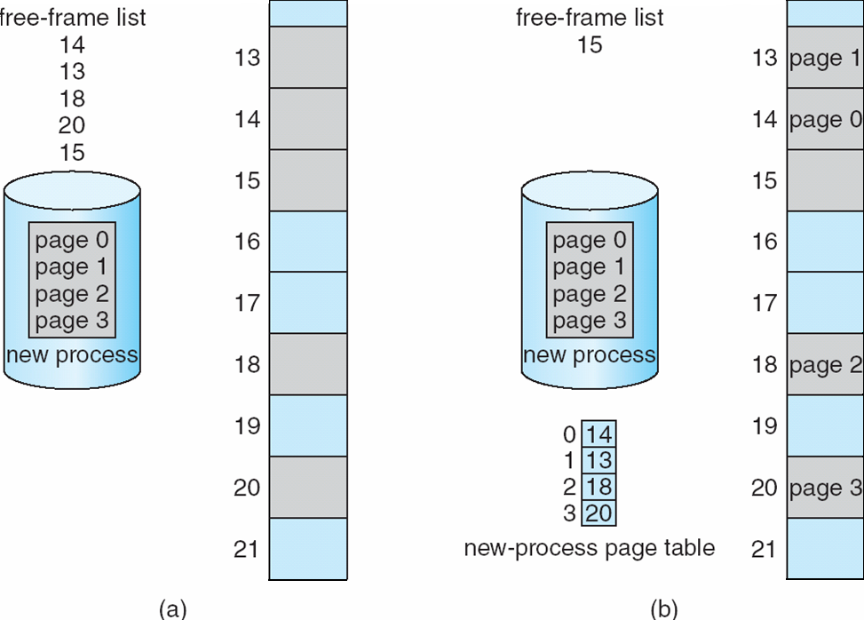
Free Frames
Before allocation
After allocation
Notes:
-When a process arrives to be executed and has n pages, it’s allotted n frames if available. Pages are loaded into frames and the page table is updated after each step.
-Frame Table is a data structure maintained by the OS that has info about each frame in physical memory (free, allocated, allocated to which page of which process).

Slide 42
Implementation of Page Table
Page table is kept in main memory
Page-table base register (PTBR) points to the page table
Page-table length register (PTLR) indicates size of the page table
In this scheme every data/instruction access requires two memory accesses
One for the page table and one for the data/instruction
The two memory access problem can be solved by the use of a special fast-lookup hardware cache called associative memory or translation look-aside buffers (TLBs)
Notes:
-PTBR kept in PCB. Only PTBR has to be reloaded after context-switch to this process.
-Rarely do processes use all their allowed address range; usually they use only a small fraction of it. Wasteful to keep page table with all unused frames as well. PTLR used to indicate size of page table. Any access beyond it is illegal.
-Some OSes implement page tables in fast registers or copy the page table in memory into these registers. This saves the two memory accesses.
But unfeasible for large page tables.
-TLB is based on the observation that processes access a few pages most of the time.
-TLB usually inside the MMU, and MMU now mostly on the CPU chip.

Slide 43
Implementation of Page Table (Cont.)
Some TLBs store address-space identifiers (ASIDs) in each TLB entry – uniquely identifies each process to provide address-space protection for that process
Otherwise need to flush at every context switch
TLBs typically small (64 to 1,024 entries)
On a TLB miss, value is loaded into the TLB for faster access next time
Replacement policies must be considered
Some entries can be wired down for permanent fast access
Notes:
-ASIDs for several processes at a time in TLB. Otherwise, at each context switch, TLB would have to be flushed and reloaded with only entries for current process.

Slide 44
Associative Memory
Associative memory – parallel search
Address translation (p, d)
If p is in associative register, get frame # out
Otherwise get frame # from page table in memory
Notes:
-TLB/associative memory is a small hardware cache that is very fast. Usually has between 64 and 1024 entries.
-When presented with a page#, a search of all the TLB is made at once, i.e. in parallel. Unlike RAM, each memory bit here has its own comparison circuit.
http://en.wikipedia.org/wiki/Content-addressable_memory#Semiconductor_implementations
-If TLB is full, then need to evict some entries for new ones. Random replacement, and replacement of least recently used entries (those used
earliest in time) are two popular strategies of replacement.
-http://en.wikipedia.org/wiki/CPU_cache#Associativity

Slide 45
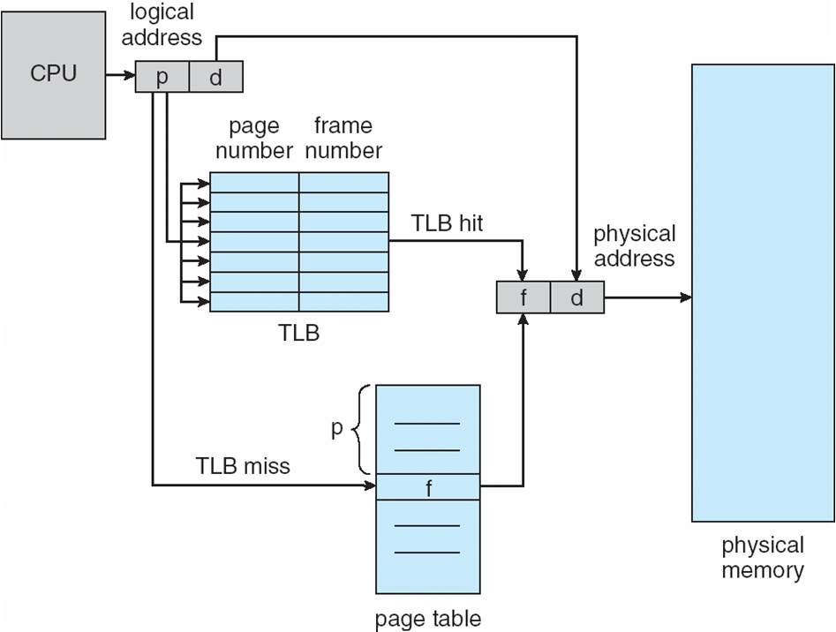
Paging Hardware With TLB
Notes:
[TLB miss arrow should also come from the TLB. It checks there first and if there is a miss, it has to consult the page table.]

Slide 46
Effective Access Time
Associative Lookup = ε time unit
Can be < 10% of memory access time
Assume memory access time is 1 time unit
Hit ratio = α
Hit ratio – percentage of times that a page number is found in the associative registers; ratio related to number of associative registers
Effective Access Time (EAT) [ (H)(TLB access time + mem access time) + (1-H)(TLB access + PT access + mem access)]
Ignored ε for the numerical as it’s small
Consider α = 80%, ε = 20ns for TLB search, 100ns for memory access
EAT = 0.80 x 100 + 0.20 x 200 = 120ns
Consider more realistic hit ratio: α = 99%, ε = 20ns for TLB search, 100ns for memory access
EAT = 0.99 x 100 + 0.01 x 200 = 101ns
Notes:
-Ignored ε for the numerical as it’s small. The access time without TLB would have been 200 ns always (page table memory access + memory access).

Slide 47
Memory Protection
Memory protection implemented by associating protection bit with each frame to indicate if read-only or read-write access is allowed
Can also add more bits to indicate page execute-only, and so on
Valid-invalid bit attached to each entry in the page table:
“valid” indicates that the associated page is in the process’ logical address space, and is thus a legal page
“invalid” indicates that the page is not in the process’ logical address space
Or use page-table length register (PTLR)
Notes:
-Additional bits can be there against each entry e.g. to show whether the page is read-only, read-write or execute-only. Any access by the process violating the access type(s) allowed, as indicated by the protection bits for each page, generates a hardware trap to the OS, indicating memory-protection violation.

Slide 48
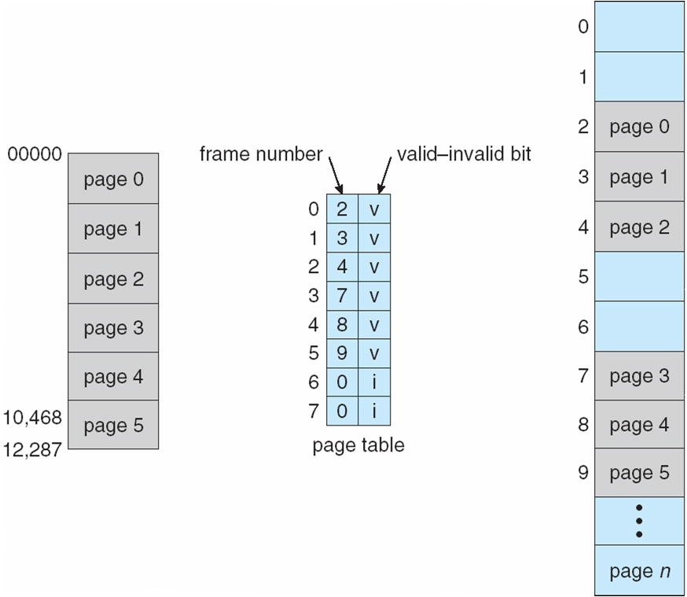
Valid (v) or Invalid (i) Bit In A Page Table

Slide 49
Shared Pages
Shared code
One copy of read-only (reentrant) code shared among processes (i.e., text editors, compilers, window systems)
Similar to multiple threads sharing the same process space
Also useful for interprocess communication if sharing of read-write pages is allowed
Private code and data
Each process keeps a separate copy of the code and data
The pages for the private code and data can appear anywhere in the logical address space
Notes:
-Reentrant code is one that never changes during execution. Thus multiple processes can use it simultaneously.
-Suppose 20 users using a text editor that has 50 KB of code and 10 KB of data space. Would require 1200 KB if no sharing.
-With sharing, only 250 KB needed.

Slide 50
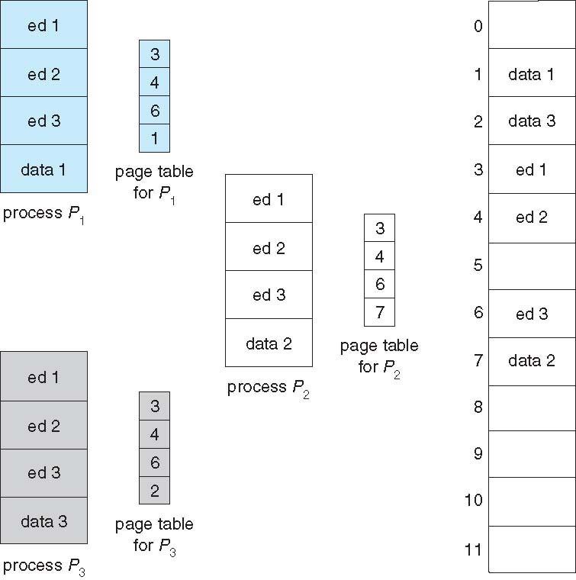
Shared Pages Example
Notes:
-Sharing of memory among processes on a system is similar to the sharing of address space of a task by threads.
-Shared pages are also a means by which some OSes do interprocess communication by sharing memory.

Slide 51
The slides 8.51-8.61 are for self-study

Slide 52
Structure of the Page Table
Memory structures for paging can get huge using straight-forward methods
Consider a 32-bit logical address space as on modern computers
Page size of 4 KB (2¹²)
Page table would have 1 million entries (2³² / 2¹²)
If each entry is 4 bytes -> 4 MB of physical address space / memory for page table alone
That amount of memory used to cost a lot
Don’t want to allocate that contiguously in main memory
Hierarchical Paging
Hashed Page Tables
Inverted Page Tables
Notes:
-3 different schemes to structure page tables.

Slide 53
Hierarchical Page Tables
Break up the logical address space into multiple page tables
A simple technique is a two-level page table
We then page the page table

Slide 54
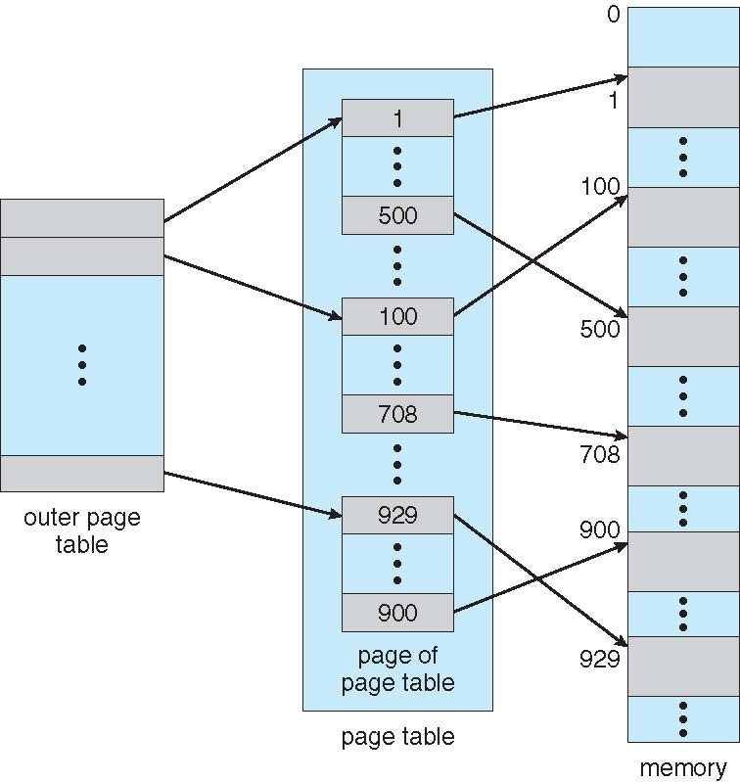
Two-Level Page-Table Scheme

Slide 55
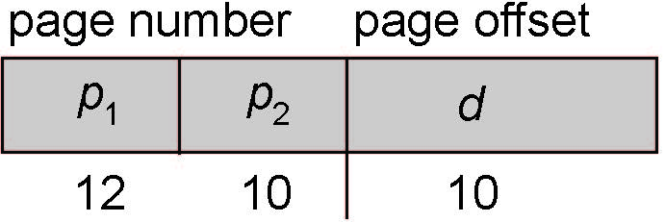
Two-Level Paging Example
A logical address (on 32-bit machine with 1K page size) is divided into:
a page number consisting of 22 bits
a page offset consisting of 10 bits
Since the page table is paged, the page number is further divided into:
a 12-bit page number
a 10-bit page offset
Thus, a logical address is as follows:
where p₁ is an index into the outer page table, and p₂ is the displacement within the page of the inner page table
Known as forward-mapped page table
Notes:
-Address space=2^32. Page size=2^10 bytes.
Hence we have to have an offset of 10 bits.
Total number of pages is (2^32)/(2^10) i.e. 2^22.
The same m and m-n bits logic as before, of course.
Therefore, obviously, the first 22 bits of address would pinpoint the page and the next 10 bits of address would give us the offset within that page.
-The total size of the page table in bytes is equal to the number of pages, which is 2^22 i.e. 4 MB (1 MB = 2^20 bytes).
This is too large to be kept contiguously. So break it up into pages.
-We have broken the 22 bit address into 12 bits for the outer page table, which thus has 2^12 entries, and hence there are 2^12 pages in the inner page table, each holding 2^10 entries (this size 2^10 is a convenient size chosen by us, which makes each page of page table equal to the page of other memory, assuming 1-byte entries.
Hence, 10 bits required for getting to the required frame in the page of the inner page table. The offset then gives, as before, the physical address within that frame.
-Total memory taken up by pages of page tables is now 2^12 (outer) + (2^12 x 2^10) (inner page table) = 4KB + 4MB, i.e. a very slight increase from 4MB but convenience of noncontiguous allocation. Also, we don’t keep all pages of page table in memory; only the used ones.

Slide 56
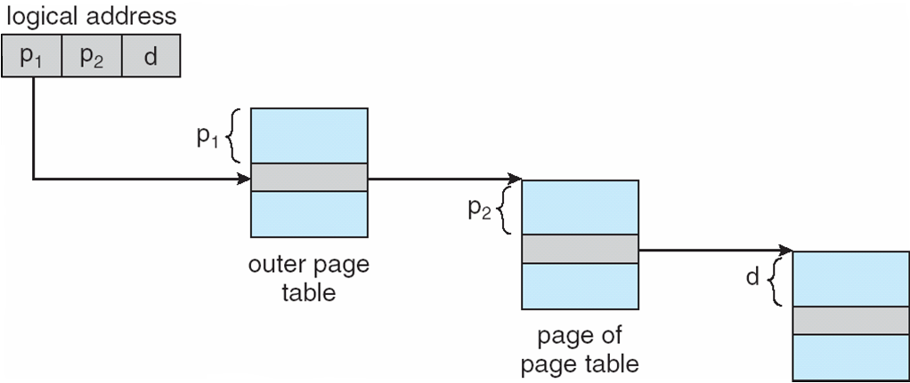
Address-Translation Scheme
Notes:
-d is the displacement within the corresponding physical frame.
-Book examples assume 4 bytes per entry and a 4KB (2^12) page size. Hence they take a page table page of 2^10 entries to make it 2^12 in size.
-2^10 is Kilo
2^20 (square of Kilo) is Mega (M)
2^30 (cube of Kilo) is Giga (G)
2^40 is Tera (T)
2^50 is Peta (P)
2^60 is Exa (E)
2^70 is Zetta (Z)
2^80 is Yotta (Y)

Slide 57
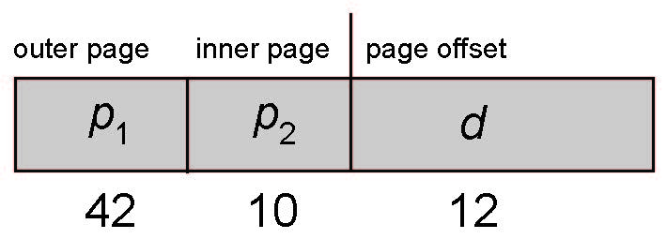
64-bit Logical Address Space
Even two-level paging scheme not sufficient
If page size is 4 KB (2¹²)
Then page table has 2⁵² entries
If two level scheme, inner page tables could be 2¹⁰ 4-byte entries
Address would look like
Outer page table has 2⁴² entries or 2⁴⁴ bytes
One solution is to add a 2nd outer page table
But in the following example the 2nd outer page table is still 2³⁴ bytes in size
And possibly 4 memory access to get to one physical memory location

Slide 58
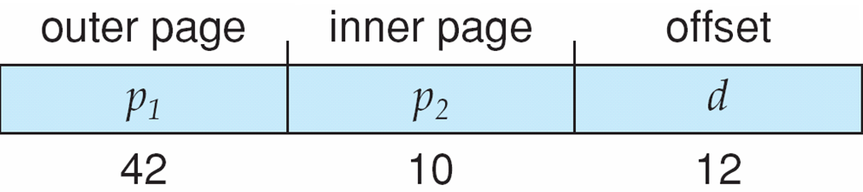
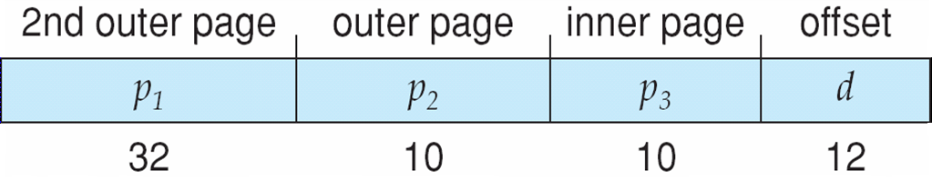
Three-level Paging Scheme
Notes:
-64 bit address space with 4KB (2^12) pages.
-First diagram depicts 2 level paging. Outer page table is 2^42 entries big; too big.
So break it up into an outer page of 2^32 entries and one of 2^10 entries (so that page is of size 2^10 x 4 bytes per entry = 2^12 bytes = 4KB).
-Draw diagrams. Compare the increase in page table storage size as compared to a single contiguous page table. It’s very slight.
-Paging to 2, 3 and 4 levels is done usually in 32-bit architectures e.g. Motorola 68030 has 4-level paging scheme.
-For 64-bit architectures, even more levels are required, and hence this paging scheme is not appropriate there as these are too many memory accesses to resolve one virtual address.

Slide 59
Hashed Page Tables
Common in address spaces > 32 bits
The virtual page number is hashed into a page table
This page table contains a chain of elements hashing to the same location
Each element contains (1) the virtual page number (2) the value of the mapped page frame (3) a pointer to the next element
Virtual page numbers are compared in this chain searching for a match
If a match is found, the corresponding physical frame is extracted
Variation for 64-bit addresses is clustered page tables
Similar to hashed but each entry refers to several pages (such as 16) rather than 1
Especially useful for sparse address spaces (where memory references are non-contiguous and scattered)
Notes:
http://en.wikipedia.org/wiki/Hash_table
-Quick searching through hashing. Can have O(1) search, i.e. constant time.
-Use chaining method of hashing.
-Each element in the linked list comprises:
1)the virtual page number 2)the mapped page frame 3)pointer to next list element
-Virtual page number is hashed and then searched in that linked list for a match.

Slide 60
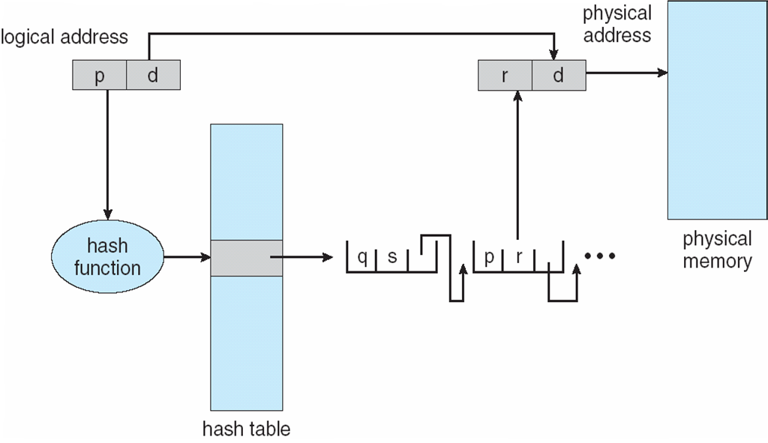
Hashed Page Table
Notes:
-On average, fewer memory accesses per lookup than using hierarchical page tables (for large address spaces).

Slide 61
Inverted Page Table
Rather than each process having a page table and keeping track of all possible logical pages, track all physical pages
One entry for each real page of memory
Entry consists of the virtual address of the page stored in that real memory location, with information about the process that owns that page
Decreases memory needed to store each page table, but increases time needed to search the table when a page reference occurs
Use hash table to limit the search to one — or at most a few — page-table entries
TLB can accelerate access
But how to implement shared memory?
One mapping of a virtual address to the shared physical address
Notes:
-In normal page table scheme, the virtual addresses are as many as the address space. I.e. each process has an associated page table and the page table has one entry for each page that the process is using (one slot for each virtual address , regardless of the latter’s validity).
E.g. for 64-bit address space and 4KB pages, we need 2^52 entries in the page table. Too large.
-Usually, RAM is not as large as the maximum. E.g. not 2^64 but, say, 1GB (i.e. 2^30). Then this normal paging is wasteful.
-Use inverted, in which only the 1GB actual RAM/physical memory entries are used. It uses only 2^m entries inverted page table for physical memory of 2^m frames.
I.e. 2^30/2^12 = 2^18 entries needed. This is equal to only 256K (2^10x2^8) of inverted page table size. The virtual addresses can still span the entire 2^64 bit range, but will in totality be less than 1GB as that’s the memory available. So will be mapped to within that.
-Only one inverted page table instead of one for each process. Hence, pid needed to differentiate between same logical addresses of processes while searching in the inverted table.
-Hashing on virtual address gives a page table entry. In case of collision, have to search linked list. Store frame number along with the virtual address for each address. Same scheme as before, with only difference that size of table is smaller (only equal to actual RAM size, not logical
address space).
-Examples of systems using this include UltraSPARC and PowerPC.
-http://www.cs.nmsu.edu/~pfeiffer/classes/573/notes/ipt.html
Animation: http://cs.uttyler.edu/Faculty/Rainwater/COSC3355/Animations/invertedpagetable.htm
-Read the scanned pages on paging from Tanenbaum.

Slide 62
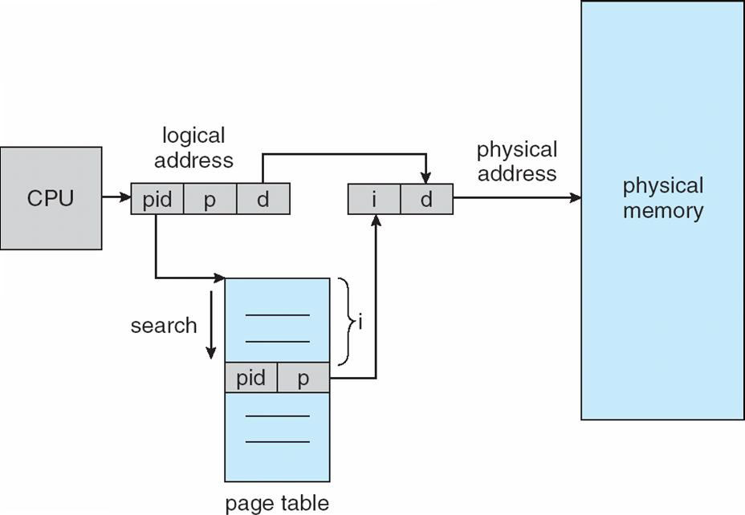
Inverted Page Table Architecture
Notes:
-pid used for protection (assumes role of address-space identifier).
-’i’ denotes the frame number, and is obtained as the sequential number of the location in the table where virtual address match was found.
-Difficult to implement shared memory.
-If no match found, an illegal access has been attempted.
Also see Hashed Inverted Page Table, and notes on Linear Inverted Page Table and TLB in:
http://www.cs.berkeley.edu/~kamil/teaching/sp04/040104.pdf

Slide 63
End of Chapter 8

